Slide 1
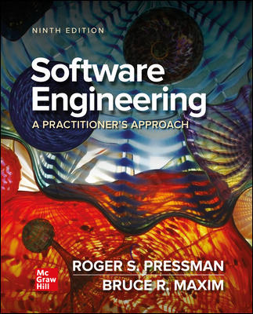
Chapter 22
Software Configuration Management.
Part Three – Quality and Security.

Slide 2
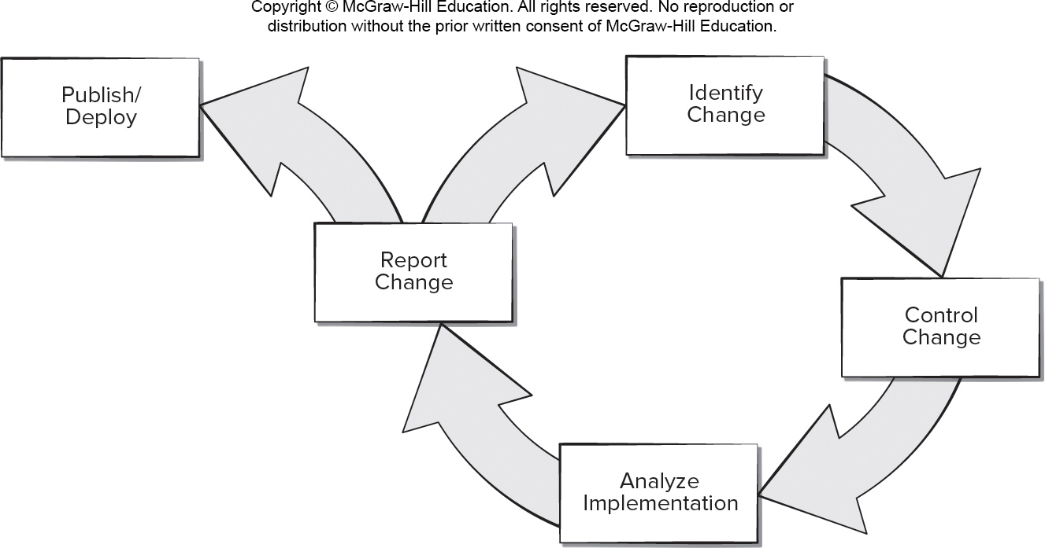
Software Configuration Management Work Flow
Access the text alternative for slide images.

Slide 3
Configuration Management System Elements
Component elements. A set of tools coupled within a file management system (for example, a database) that enables access to and management of each software configuration item.
Process elements. A collection of procedures and tasks that define an effective approach to change management (and related activities) for all constituencies involved in the management, engineering, and use of computer software.
Construction elements. A set of tools that automate the construction of software by ensuring that the proper set of validated components (that is, the correct version) have been assembled.
Human elements. A set of tools and process features (encompassing other CM elements) used by the software team to implement effective S C M.

Slide 4
Baselines
The I E E E defines a baseline as: A specification or product that has been formally reviewed and agreed upon, that thereafter serves as the basis for further development, and that can be changed only through formal change control procedures.
A baseline is a milestone in the development of software that is marked by the delivery of one or more software configuration items and the approval of these S C I that is obtained through a formal technical review.

Slide 5
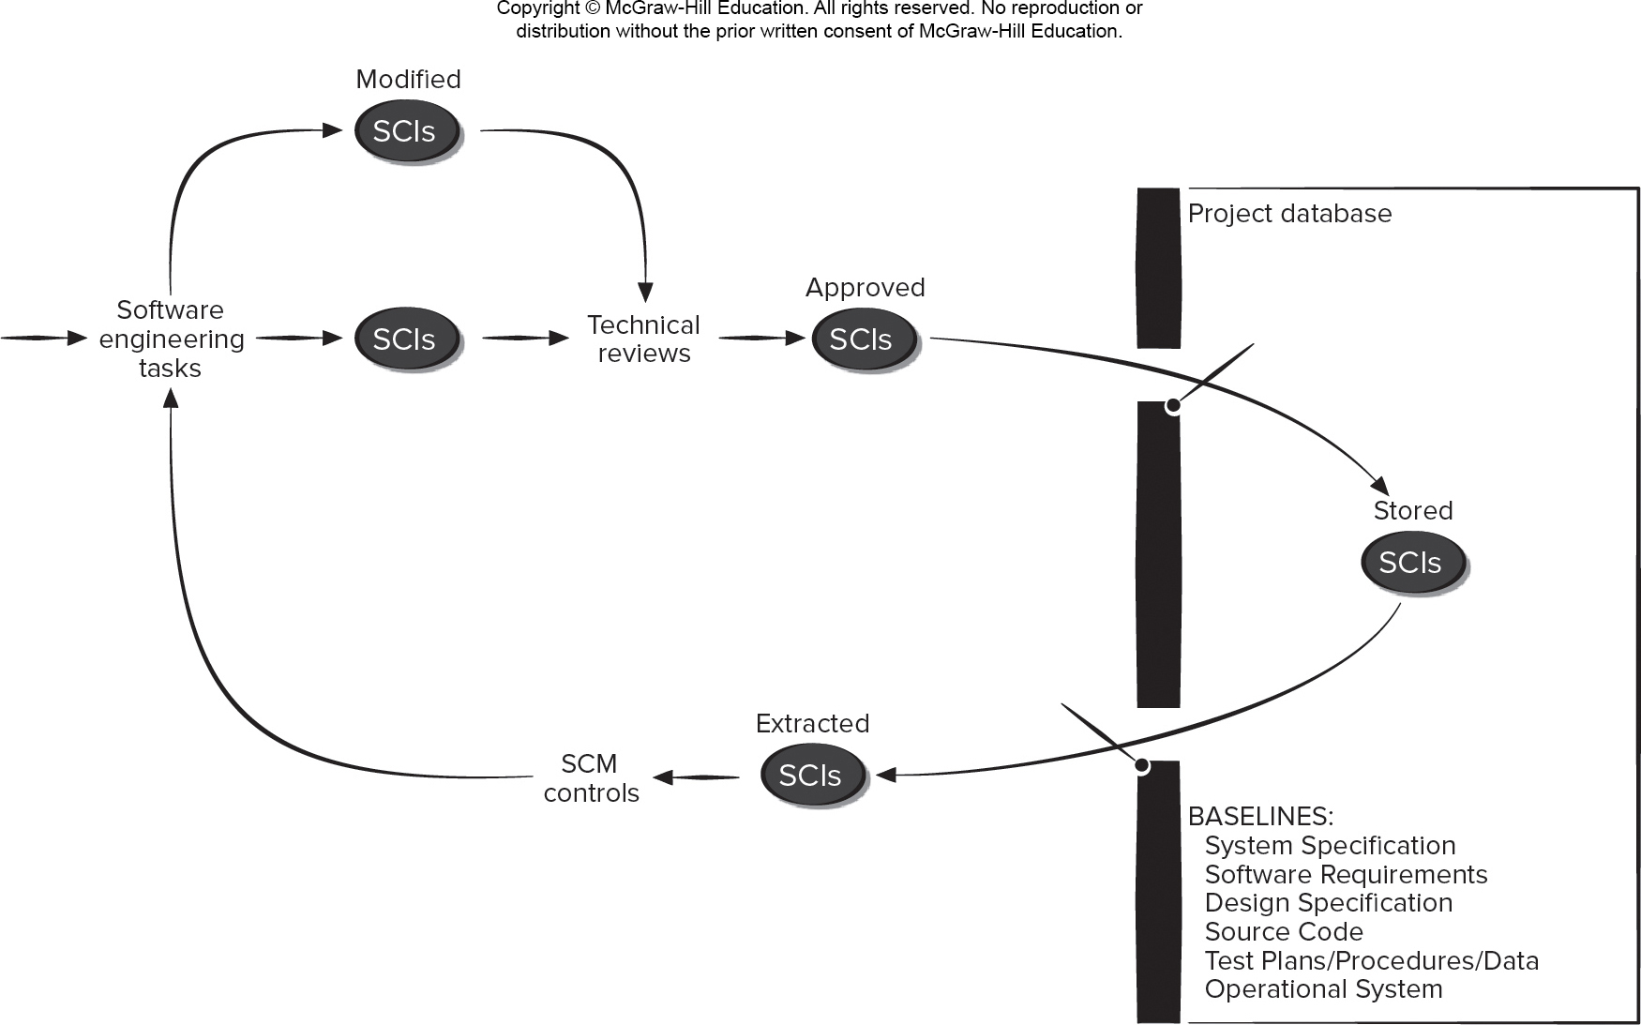
Baselined Software Configuration Items
Access the text alternative for slide images.

Slide 6
Management of Dependencies and Changes
It is important for developers to maintain software work products to ensure the dependencies among the S C I are documented.
Developers must establish discipline when checking items in and out of the S C M repository.
Impact management involves two complementary aspects:
Ensuring that developers employ strategies to minimize the impact of their colleagues’ actions on their own work.
Encouraging software developers to use practices that minimize the impact of their own work on that of their colleagues.

Slide 7
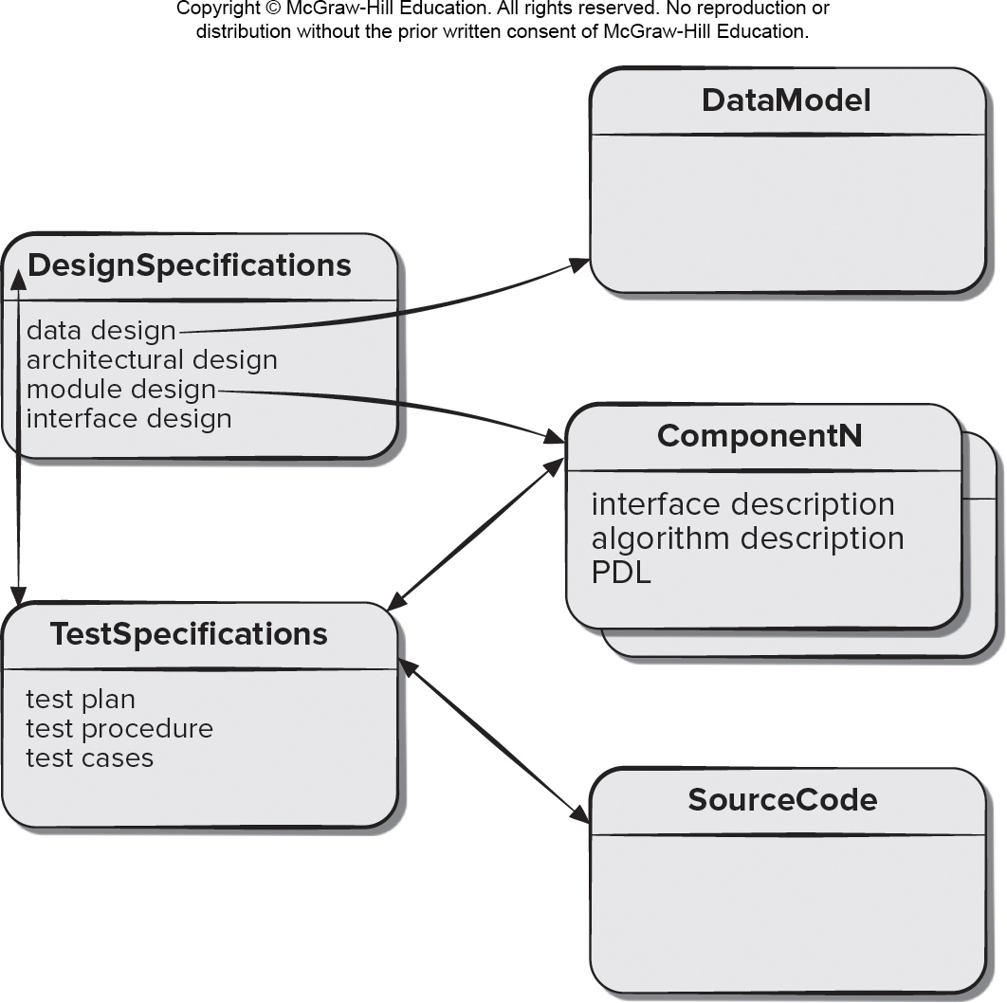
Software Configuration Items
Access the text alternative for slide images.

Slide 8
S C M Repository 1
The S C M repository is the set of mechanisms and data structures that provides the following functions that allow a software team to manage change:
Data integrity.
Information sharing.
Tool integration.
Data integration.
Methodology enforcement.
Document standardization.

Slide 9
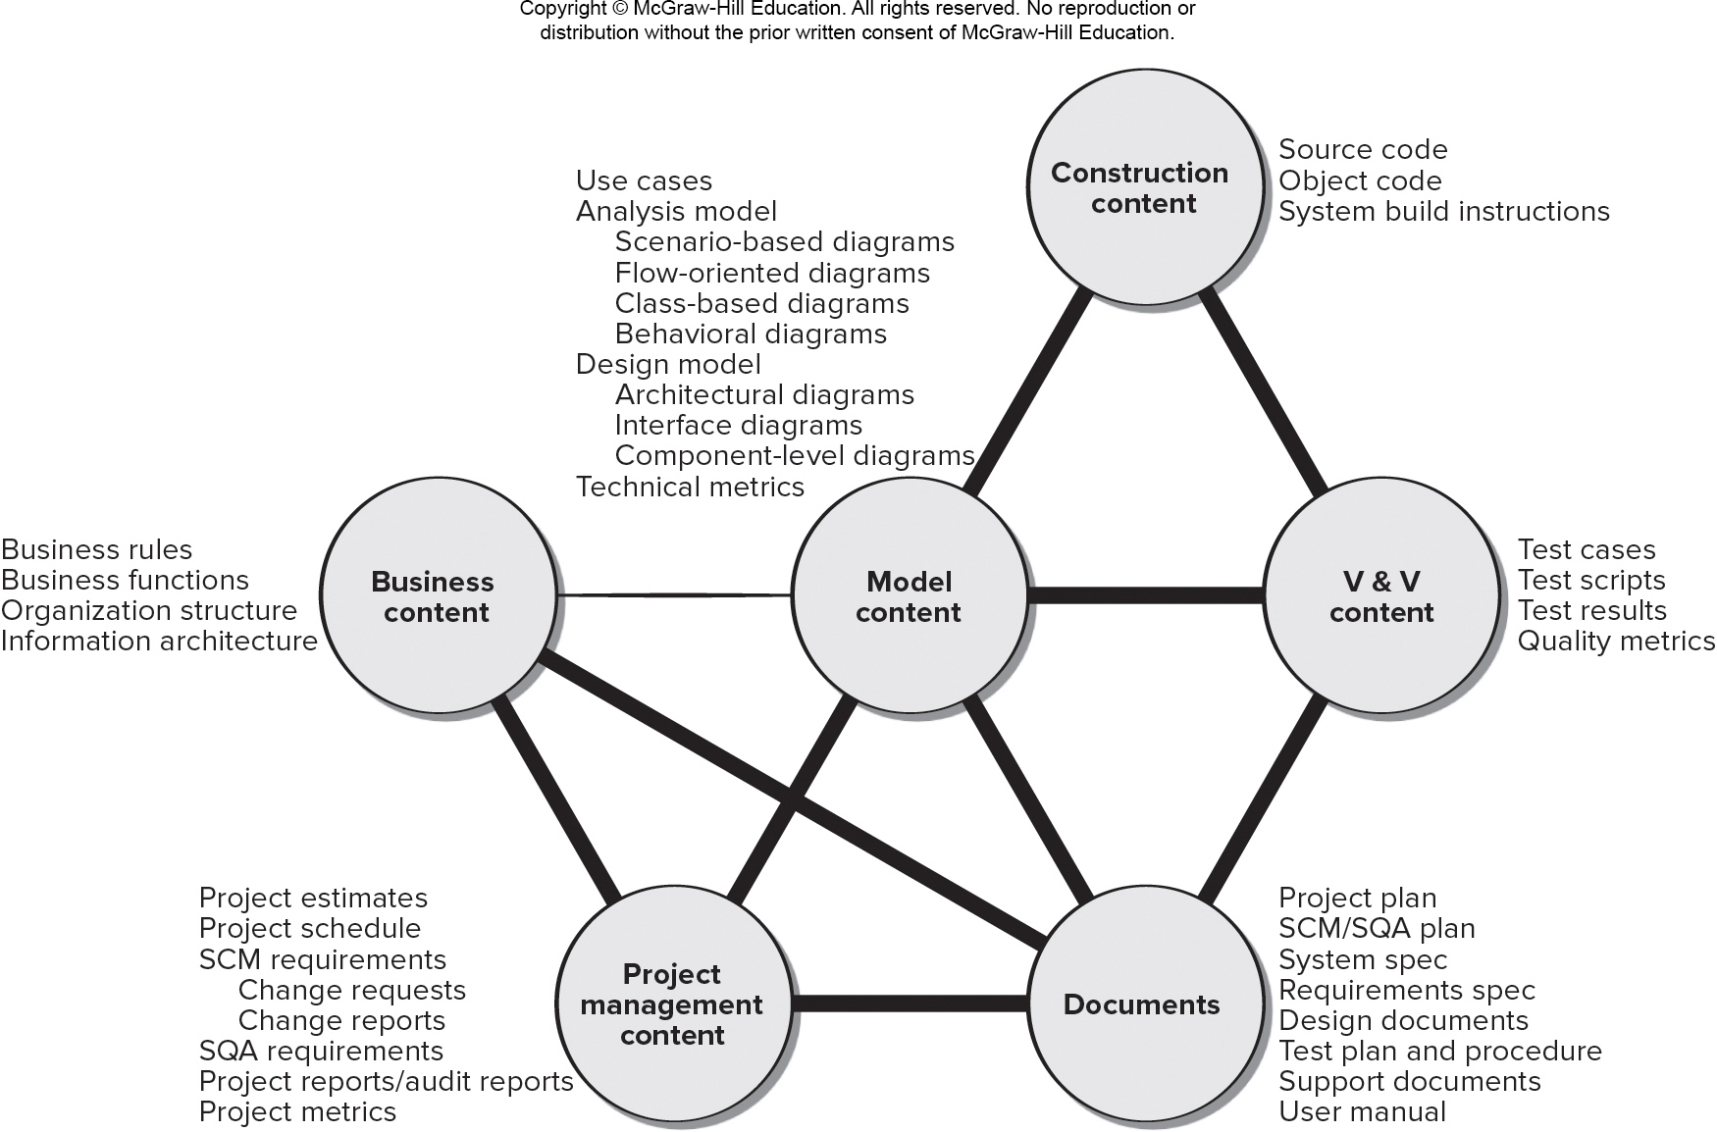
S C M Repository 2
Access the text alternative for slide images.

Slide 10
SCM Repository Features
Versioning. - saves versions to manage product releases and allow developers to go back to previous versions.
Dependency tracking and change management. - manages a wide variety of relationships among the data elements stored in it.
Requirements tracing. - provides the ability to track all design and construction components and deliverables resulting from a specific requirement specification.
Configuration management. - tracks series of configurations representing specific project milestones or production releases and provides version management.
Audit trails. - establishes additional information about when, why, and by whom changes are made.

Slide 11
SCM Best Practices
Keeping the number of code variants small.
Test early and often.
Integrate early and often.
Use tools to automate testing, building, and code integration.

Slide 12
Continuous Integration Advantages
Accelerated feedback. Notifying developers immediately when integration fails allows fixes when the number of changes is small.
Increased quality. Building and integrating software whenever necessary provides confidence into the quality of the product.
Reduced risk. Integrating components early avoids a long integration phase, design failures are discovered and fixed early.
Improved reporting. Providing additional information (for example, code analysis metrics) allows for accurate configuration status accounting.
CI is becoming a key technology as software organizations begin their shift to more agile software development processes.
Early defect capture always reduces the development costs.

Slide 13
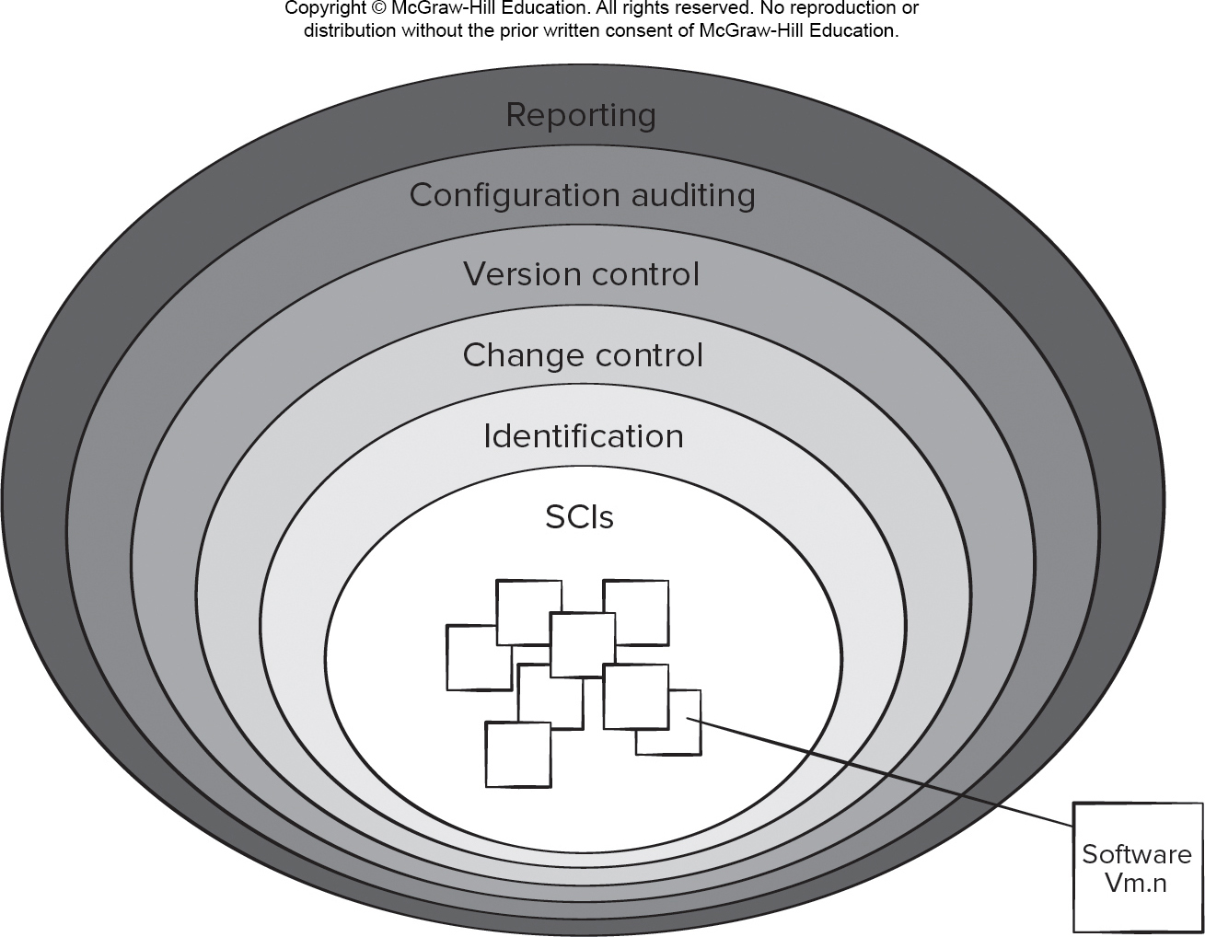
S C M Process Layers
Access the text alternative for slide images.

Slide 14
Change Management Objectives
Software change management process defines a series of tasks that have four primary objectives:
To identify all items that collectively define the software configuration.
To manage changes to one or more of these items.
To facilitate the construction of different versions of an application.
To ensure that software quality is maintained as the configuration evolves over time.

Slide 15
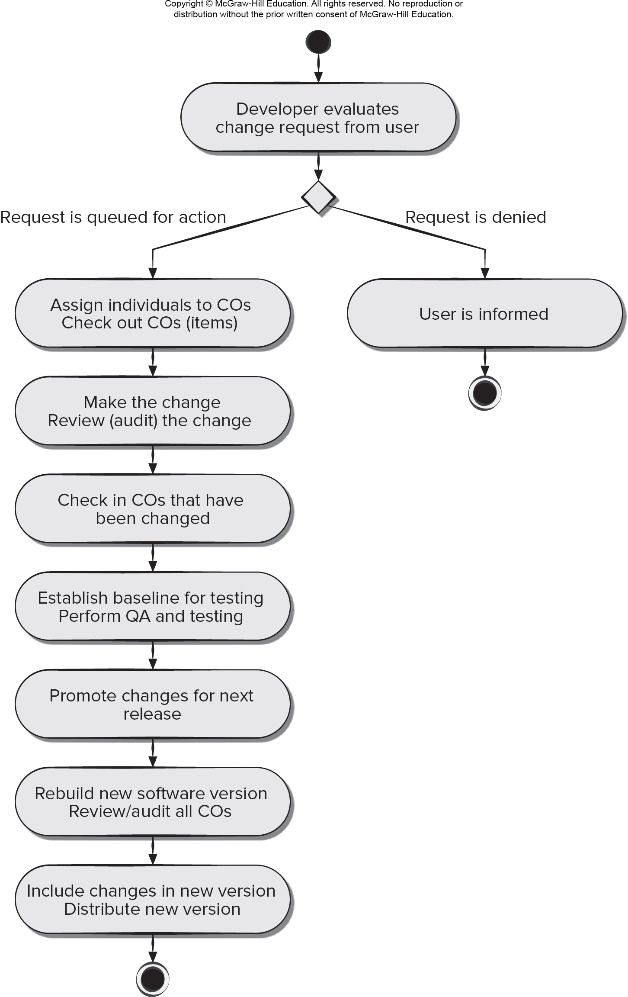
Change Control Process
Access the text alternative for slide images.

Slide 16
Impact Management
A web of software work product interdependencies must be considered every time a change is made.
Impact management is accomplished with three actions:
An impact network identifies the stakeholders who might effect or be affected by changes that are made to the software based on its architectural documents.
Forward impact management assesses the impact of your own changes on the members of the impact network and then informs members of the impact of those changes.
Backward impact management examines changes that are made by other team members and their impact on your work and incorporates mechanisms to mitigate the impact.

Slide 17
Software Configuration Audit
Software configuration audit complements a technical review by asking and answering the following questions:
Has the change specified in the E C O been made? Have any additional modifications been incorporated?
Has a technical review been conducted to assess technical correctness?
Has the software process been followed, and have software engineering standards been properly applied?
Has the change been “highlighted” in the S C I? Do the attributes of the configuration object reflect the change?
Have S C M procedures for noting the change, recording it, and reporting it been followed?
Have all related S C I been properly updated?

Slide 18
Configuration Status Reporting (C S R)
Configuration status reporting is an S C M task that answers the following questions any time a change or audit occurs:
What happened?
Who did it?
When did it happen?
What else will be affected?
Output from C S R may be placed in an online database or website, so that software developers or support staff can access change information by keyword category.

Slide 19
Mobility and Agile Change
Mobile developers and game developers use an iterative, incremental process model that applies many agile principles.
An engineering team often develops an increment in a very short time period using a customer-driven approach.
Subsequent increments add additional content and functionality, and each is likely to implement changes that lead to enhanced content, better usability, improved aesthetics, better navigation, enhanced performance, and stronger security.
Members of software teams that build apps or games must embrace change, but do not want excessive bureaucracy.
Traditional S C M principles, practices, and tools must be molded them to meet the special needs of mobile projects.

Slide 20
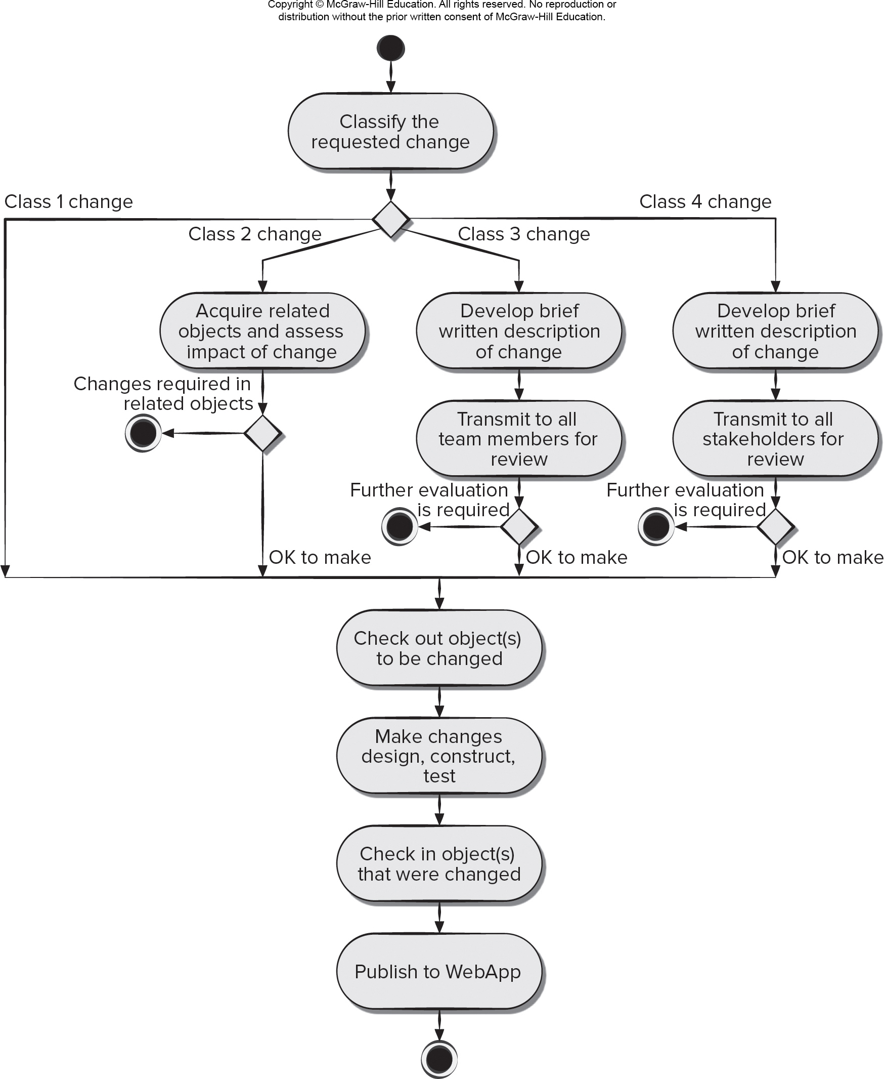
Agile Change Management
Access the text alternative for slide images.

Slide 21
Content Management 1
Collection subsystem encompasses all actions required to create or acquire content, and the technical functions that are necessary to:
Convert content into a form that can be represented by a mark-up language (for example, H T M L, X M L).
Organize content into packets that can be displayed effectively on the client-side.
Management subsystem implements a repository that encompasses:
Content database - information structure to store all content objects.
Database capabilities - functions to search for content objects, store and retrieve objects, and manage the content file structure.
Configuration management functions - supports content object identification, version control, change management, change auditing, and reporting.

Slide 22
Content Management 2
Publishing subsystem - extracts content from the repository, converts it to a publishable form, and formats it so that it can be transmitted to client-side browsers.
The publishing subsystem uses a series of templates for each type:
Static elements—text, graphics, media, and scripts that require no further processing are transmitted directly to the client-side.
Publication services—function calls to specific retrieval and formatting services that personalize content (using predefined rules), perform data conversion, and build appropriate navigation links.
External services—provide access to external corporate information infrastructure such as enterprise data or “back-room” applications.

Slide 23
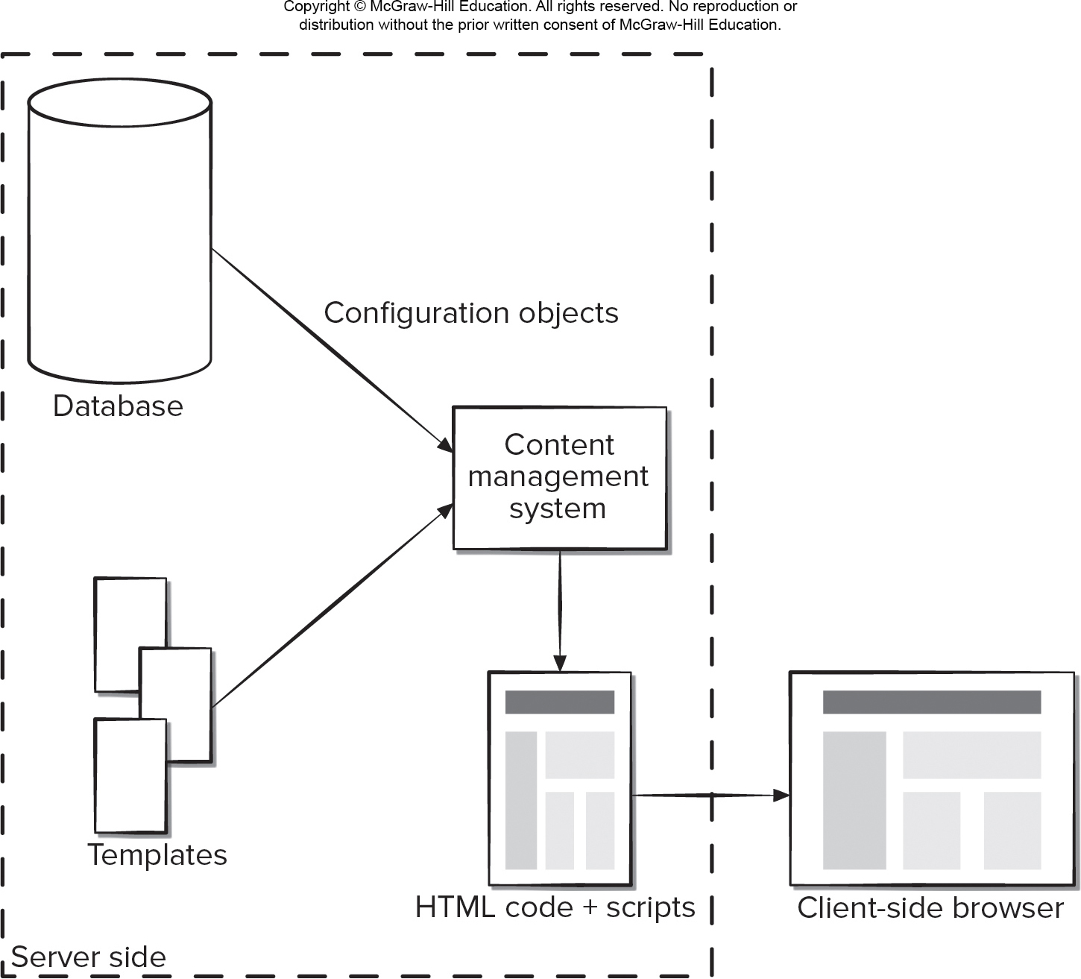
Content Management System
Access the text alternative for slide images.

Slide 24
Version Control
As apps and games evolve through a series of increments different versions may exist at the same time and version control process is required to avoid overwriting changes:
A central repository for the app or game project should be established.
Each developer creates his own working folder.
The clocks on all developer workstations should be synchronized.
As new configuration objects are developed or existing objects are changed, they are imported into the central repository.
As objects are imported or exported from the repository, an automatic, time-stamped log message is made.

Slide 25
Auditing and Reporting
Interest of agility, auditing and reporting functions are deemphasized during development of games or apps.
As objects are checked into or out of the repository the action is recorded in a log that can be reviewed.
Complete log report can be generated at time one id needed o that all members of the team have a chronology of changes.
An e-mail notification can be generated automatically any time an object is checked in or out of the repository.

Slide 26
End of Main Content

Slide 27
Accessibility Content: Text Alternatives for Images

Slide 28
Software Configuration Management Work Flow – Text Alternative
Return to parent-slide containing images.
An illustration displays software configuration management work flow. The steps in the cycle diagram are identify change, control change, analyze implementation, and report change, and the circle continues to identify change or move to publish or deploy.
Return to parent-slide containing images.

Slide 29
Baselined Software Configuration Items – Text Alternative
Return to parent-slide containing images.
A flow diagram shows baselined software configuration items. An input is provided to software engineering tasks. Software engineering tasks creates S C I which pass through technical reviews which approve the S C I. Approved S C I are stored in the project database. The baselines in the project database are as follow: system specification, software requirements, design specification, test plants or procedures or data, operational system. The stored S C I are extracted S C I and are fed to the S C M controls. The diagram flow here loops back to software engineering tasks from S C M controls. At this point the loop can either take the flow mentioned above or from software engineering tasks modified S C I are created which pass through a technical review and become an approved S C I.
Return to parent-slide containing images.

Slide 30
Software Configuration Items – Text Alternative
Return to parent-slide containing images.
A diagram displays software configuration items. The items are design specifications, test specifications, data model, component N, and source code. The design specifications include data design, architectural design, module design, and interface design. The test specifications include test plan, test procedure, and test cases. The component N include interface description, algorithm description, and P D L. The design specifications and test specifications are connected with a double arrow. The data design is connected to the data model with an arrow, and the module design is connected with the component N. The component N and source code are connected to the test specifications with double arrows.
Return to parent-slide containing images.

Slide 31
S C M Repository 2 – Text Alternative
Return to parent-slide containing images.
An illustration displays SCM repository flow chart. It has three levels. The first level on the top reads construction content. The second level in the middle reads business content, model content, and V and V content. The third level in the bottom reads project management content, and documents. The documents reads project plan, SCM or SQA plan, system spec, requirements spec, design documents, test plan and procedures, support documents, and user manual. The project management content reads project estimates; project schedule; SCM requirements with change requests, and change reports; SQA requirements, project reports or audit reports; and project metrics. The business content reads business rules, business functions, organization structure, and information architecture. The model content reads, use cases; analysis model with scenario based diagrams flow oriented diagrams, class based diagrams, and behavioral diagrams; design model with architectural diagrams, interface diagrams, and component level diagrams; and technical metrics. The V and V content reads test cases, test scripts, test results, and quality metrics. The construction content reads source code, object code, and system build instructions. The project management is connected to documents, model content, and business content. The documents is connected to V and V content, model content, and business content. The business content is connected to project management content, documents, and model content. The model content is connected to business content, project management content, documents, V and V content, and construction content. The V and V content is connected to documents, model content, and construction content. The construction content is connected to just model content, and V and V content.
Return to parent-slide containing images.

Slide 32
S C M Process Layers – Text Alternative
Return to parent-slide containing images.
An illustration displays the S C M process layers. The layers from outermost to innermost are: reporting, configuration auditing, version control, change control, identification, and S C I. The inner level with S C I contains software.
Return to parent-slide containing images.

Slide 33
Change Control Process – Text Alternative
Return to parent-slide containing images.
An illustration displays the change control process. Process, developer evaluates change request from user. Decision, request is denied or request is queued for action. Request is denied, the user is informed. If the request is queued for action, then it is followed by these steps. Assign individuals to C Os and check out C Os items; make the change and review or audit the change; check in C Os that have been change; establish baseline for testing perform Q A and testing; promote changes for next release; rebuild new software version and review or audit all C Os; and include changes in new version and distribute new version.
Return to parent-slide containing images.

Slide 34
Agile Change Management – Text Alternative
Return to parent-slide containing images.
A process diagram for agile change management is as follows. Process, classify the requested change. Decision, class 1 change; class 2 change; class 3 change; class 4 change. Class 1 change process is as follows: check out objects to be changed; make changes, design, construct test; check objects that were changed; and publish to Web App. Class 2 change process is as follows: acquire related objects and assess impact of change. Decision, changes required in related objects or ok to make. If ok to make then: check out objects to be changed; make changes, design, construct test; check objects that were changed; and publish to Web App. Class 3 change process is as follows: develop brief written description of change; transmit to all team members to review. Decision, further evaluation is required or ok to make. If ok to make then: check out objects to be changed; make changes, design, construct test; check objects that were changed; and publish to Web App. Class 3 change process is as follows: develop brief written description of change; transmit to all stakeholders to review. Decision, further evaluation is required or ok to make. If ok to make then: check out objects to be changed; make changes, design, construct test; check objects that were changed; and publish to Web App.
Return to parent-slide containing images.

Slide 35
Content Management System – Text Alternative
Return to parent-slide containing images.
An illustration of a content management system. The server-side comprises: of a database, templates, and the content management system. The database provides the configuration objects to the content management system and simultaneously the templates are fed into the C M S. The C M S outputs a version with H T M L plus scripts. The H T M L plus scripts are translated to produce the client-side browser version.
Return to parent-slide containing images.

